Slide 1
Functions
JS
Presented By : Asmaa Ahmed

Slide 2
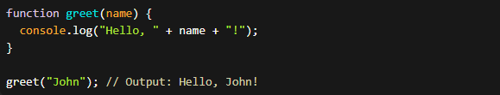
Named Function
Named Functions:
Named functions are defined with a specified name and can be called by their name.
Named functions are useful when you want to reuse the same function in multiple places or when you need to refer to the function by its name

Slide 3

Arrow Functions
Arrow functions provide a concise syntax for writing functions, with an implicit return and a lexical this binding.
Arrow functions are especially useful for writing short, one-line functions or when you want to preserve the lexical this context.

Slide 4
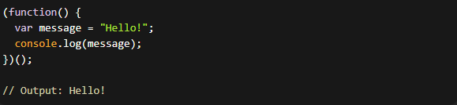
IIFE Function
IIFE (Immediately Invoked Function Expression):
An IIFE is an anonymous function that is immediately executed.
IIFEs are commonly used to create a private scope, preventing variables from polluting the global scope.

Slide 5

Anonymous Function
An anonymous function is a function without a name and is usually used as an argument to other functions.

Slide 6
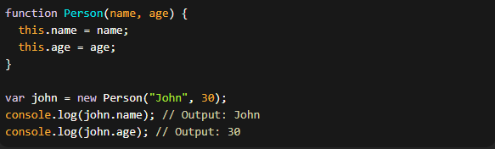
Constructor Functions
Constructor functions are used to create objects with a shared structure and behavior. They are typically invoked with the new keyword.
Constructor functions are used to create multiple instances of objects with similar properties and methods.

Slide 7
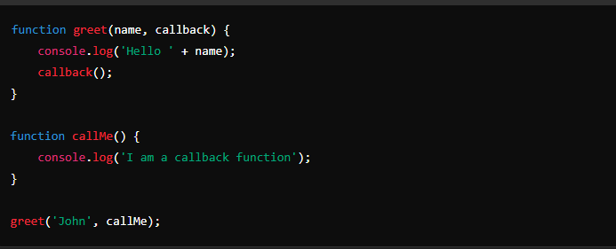
Callback Function
A callback function is passed as an argument to another function and is executed after some operation has been completed.

Slide 8
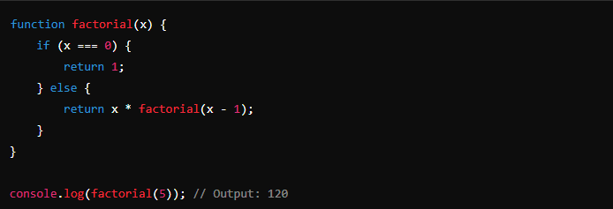
Recursive Function
A recursive function is a function that calls itself until it reaches a base condition. This is often used for tasks that can be broken down into similar subtasks.

Slide 9
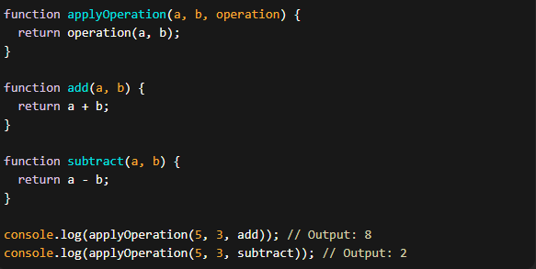
Higher-Order Functions
Higher-order functions are powerful tools for abstraction and composition, allowing you to create more flexible and reusable code.

Slide 10
Thanks!
Do you have any questions?
asmaaahmed23762@gmail.com

